Slide 1
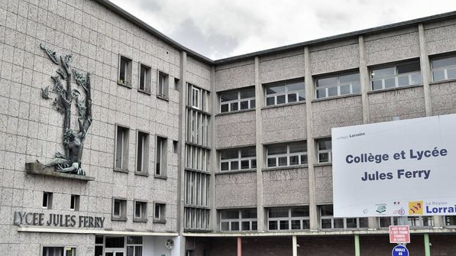
Jules Ferry High School St-Dié-des-Vosges
By Océane TOUSSAINT and
Mathilde GRAFF
1STMG3

Slide 2
Sommaire
The high school and its specificities
Possible languages to study
Students, teachers and staff
Courses
Interview of a staff member
A symbol

Slide 3
The high school and its particularities
Sports : basketball and volleyball
The city center is close, offering various activities : shops, restaurants/bakeries, a skatepark, a swimming- pool, bowling...
Lounge (accessible only to high school students and forbidden to teachers)
Boarding school with a sport hall
Jul’anim : improves the life of the students at school, it finances trips or school equipment...
Language assistant (Her name is Vera)

Slide 4
Possible languages to study
English
French
Spanish
Italian
German
Latin
Greek

Slide 5
A symbol of Jules Ferry High school
Jules Ferry is a symbol of this school because he was born in Saint-Dié-des-Vosges. He was the man who made school free and compulsory for all students in France.

Slide 6
Students, teachers and staff
211 junior high school
630 senior high school
57 bachelor students
70 teachers

Slide 7
The courses
Classes from Monday through Friday - 8am to 5pm
Possibility of eating in our cafeteria (as well as in the mornings and evenings for boarding students)

Slide 8
Nurjan’s interview
- Hey ! How are you ? I’m fine, thank you.
- Can we ask you some questions ? Yes, of course.
- Okay so, to get started, What does your work consist in ? I am an educational assistant with the students, I take care of their well-being. I take care of supervision and homework but also administrative tasks.
- Why did you choose to work here ? I applied to several places, and I got into this school.
- Do you like working here ? Yes, I like to work in contact with students and staff.
- Do you find the atmosphere pleasant ? Yes, 100% !
- What do you think should be improved here ? We should improve wellness.
- What do you prefer and what don’t you like in your job ? I like dealing with the boarders, clubs but i don’t like administrative tasks.

